Slide 1

ACHARYA INSTITUTE OF TECHNOLOGY
DEPARTMENT OF COMPUTER SCIENCE & ENGINEERING
(Affiliated to Visvesvaraya Technological University, Belagavi, Approved by AICTE, New Delhi and Accredited by NBA & NAAC)
Acharya Dr. Sarvepalli Radhakrishnan Road, Achitnagar Post, Soladevanahalli, BENGALURU – 560107
MINIPROJECT SYNOPSIS (21CSMP67) Presentation on
“GrooveGuru - Music Genre Classification and Recommendation System”
Presented by: Under the guidance of:
1. Aditi Das (1AY21CS014) Mr. M. GOWTHAM RAJ
2. Anjali K. S. (1AY21CS029) Assistant Professor
3. Bhavana B. Hallikeri (1AY16CS040) Department of CS&E
4. Deepa Tendulkar(1AY16CS051)

Slide 2
AGENDA
INTRODUCTION
LITERATURE SURVEY
REQUIREMENT ANALYSIS
PROJECT DESIGN
PROPOSED METHODOLOGY
CONCLUSION
FUTURE ENHANCEMENT

Slide 3
INTRODUCTORY SECTION

Slide 4
INTRODUCTION
1.1. Problem definition:
Develop an advanced system for music genre classification and recommendation, accurately categorizing genres and providing personalized recommendations based on user preferences and listening history.
1.2. Overview of the technical area:
Audio Signal Processing: Utilizing Librosa for extracting audio features , essential for analyzing and categorizing music files.
Machine Learning Algorithms: Implementing models like Support Vector Machine, to classify music genres based on extracted features.

Slide 5
INTRODUCTION
1.3. Overview of existing system:
Existing Systems:
Streaming Platforms: Use algorithms based on user listening history, song metadata, and collaborative filtering to recommend music.
Music Libraries: Applications like iTunes and Windows Media Player offer basic genre classification based on metadata.
Drawbacks:
Limited Accuracy: Many systems rely heavily on metadata and user behaviour, which can result in inaccurate genre classification.
1.4 Overview of Proposed System:
Audio feature extraction : Analyzes music file content to derive features for machine learning models. Utilizes “librosa” to extract critical audio features.
Machine Learning Models : Trained to recognize patterns in audio data. Uses Support Vector Machine (SVM) algorithm for precise genre classification.

Slide 6
LITERATURE SURVEY

Slide 7
LITERATURE SURVEY
S.N | PAPER TITLE & PUBLICATION DETAILS | NAME OF THE AUTHORS | TECHNICAL IDEAS / ALGORITHMS ACQUIRED FROM THE PAPER USEFULL IN DESIGNING THE PROPOSED SYSTEM | SHORTFALLS/DISADVANTAGES & SOLUTION PROVIDED BY THE PROPOSED SYSTEM
1 | Enhancing Music Genre Classification through Multi-Algorithm Analysis and User-Friendly Visualization | Navin Kamuni , Dheerendra Panwar | Naive Bayes : A probabilistic classifier based on Bayes' Theorem, known for its simplicity and effectiveness. In a project like music genre classification, where the relationship between features can be complex and non-linear, Naive Bayes might not capture the intricacies of the data as effectively as other models like SVM. | Inability to Access External Music Files: The application was limited in its ability to access and process external music files, which could have expanded the scope of its classification capabilities. Limited to Linux Environment: The application was initially developed on Linux, which may not be as widely used by the general public compared to other operating systems, potentially limiting the user base.

Slide 8
LITERATURE SURVEY
S.N | PAPER TITLE & PUBLICATION DETAILS | NAME OF THE AUTHORS | TECHNICAL IDEAS / ALGORITHMS ACQUIRED FROM THE PAPER USEFULL IN DESIGNING THE PROPOSED SYSTEM | SHORTFALLS/DISADVANTAGES & SOLUTION PROVIDED BY THE PROPOSED SYSTEM
2 | A Cascade – Hybrid Music Recommender System for mobile services based on musical genre classification and personality diagnosis | Aristomenis S.Lampropoulos et al | Personality Diagnosis : The second level of the system employs a collaborative filtering technique known as personality diagnosis. This approach predicts user preferences based on the ratings of other users with similar personality types. Collaborative Filtering : The system uses collaborative filtering to predict user preferences by comparing the active user's ratings with those of other users. | Cold Start Problem: While the system aims to address the cold start problem by using a combination of content-based and collaborative filtering techniques, it may still struggle with new users or items that have insufficient data for accurate recommendations. Dependency on User Ratings : The personality diagnosis approach relies heavily on user ratings, which may not always be available or reliable. Users may not rate items consistently or may stop providing ratings altogether.

Slide 9
LITERATURE SURVEY
S.N | PAPER TITLE & PUBLICATION DETAILS | NAME OF THE AUTHORS | TECHNICAL IDEAS / ALGORITHMS ACQUIRED FROM THE PAPER USEFULL IN DESIGNING THE PROPOSED SYSTEM | SHORTFALLS/DISADVANTAGES & SOLUTION PROVIDED BY THE PROPOSED SYSTEM
3 | Automatic music genre classification based on musical instrument track separation | Aldona Rosner , Bozena Kostek | Independent Component Analysis(ICA): The application of ICA in drum beat separation demonstrates the paper's focus on advanced signal processing techniques to improve the classification and analysis of music genres. | Instrument Influence : The study explores the influence of specific instruments on genre classification, but it may not fully capture the complexity of musical compositions and the interplay of multiple instruments within a genre. The approach may perform differently across various music genres, particularly those with complex or overlapping sound components. The separation quality might vary depending on the musical style and the nature of the audio content.

Slide 10
LITERATURE SURVEY
S.N | PAPER TITLE & PUBLICATION DETAILS | NAME OF THE AUTHORS | TECHNICAL IDEAS / ALGORITHMS ACQUIRED FROM THE PAPER USEFULL IN DESIGNING THE PROPOSED SYSTEM | SHORTFALLS/DISADVANTAGES & SOLUTION PROVIDED BY THE PROPOSED SYSTEM
4 | Music genre classification based on fusing audio and lyric information | You Li et al | Convolutional Neural Networks (CNN): The document describes the use of CNN for learning higher-order features based on the generated mel-spectrogram in the audio submodel. CNNs are commonly used for analyzing visual imagery but have also been successfully applied to audio data. Overfitting . | Experimental Settings: The document mentions that 30 seconds of audio data were directly intercepted for feature extraction. This approach might not capture the full diversity of audio characteristics within a song, potentially limiting the richness of the audio features used for classification.

Slide 11
LITERATURE SURVEY
S.N | PAPER TITLE & PUBLICATION DETAILS | NAME OF THE AUTHORS | TECHNICAL IDEAS / ALGORITHMS ACQUIRED FROM THE PAPER USEFULL IN DESIGNING THE PROPOSED SYSTEM | SHORTFALLS/DISADVANTAGES & SOLUTION PROVIDED BY THE PROPOSED SYSTEM
5 | A Survey of Music Recommendation Systems and Future Perspectives | Yading Song et al | Hybrid Models: These combine collaborative filtering and content-based approaches to leverage the strengths of both methods, potentially leading to improved recommendation performance. | Popularity Bias: The system tends to recommend popular music more frequently, potentially neglecting lesser-known or niche music.

Slide 12
PROBLEM STATEMENT

Slide 13
PROBLEM STATEMENT
Develop an advanced system, GrooveGuru, for music genre classification and recommendation, enhancing user experience in music discovery and organization.
Implement state-of-the-art audio processing using Librosa to extract critical features from music files for analysis.
Train machine learning models, specifically Support Vector Machines, to recognize audio patterns for precise genre classification and personalized recommendations.

Slide 14
REQUIREMENTS ANALYSIS FOR PROJECT IMPLEMENTATION

Slide 15
FUNCTIONAL REQUIREMENTS
Music File Upload and Processing: Facilitates user interaction by allowing seamless uploading of music files, which are processed for feature extraction essential for accurate genre classification.
Audio Feature Extraction: Extracts critical audio features from uploaded music files, providing input data for machine learning models to classify music genres accurately.
Machine Learning Model Implementation Importance: Integrates advanced machine learning algorithm such as Random forest and Decision tree to analyse extracted features and SVM and kNN to classify music genres, enhancing classification accuracy and recommendation relevance.
Personalized Recommendation System Importance: Analyzes user preferences and behaviour to generate personalized music recommendations, improving user engagement and satisfaction.
User Interface Design Importance: Develops a responsive and intuitive UI for users to interact with the system, facilitating easy navigation, result visualization, and recommendation display.

Slide 16
NON-FUNCTIONAL REQUIREMENTS
Non-functional requirements are critical to the successful implementation and operation of GrooveGuru, ensuring the system meets performance, security, usability, and scalability expectations beyond basic functional capabilities.
Overview of the importance of all the non-functional requirements :
Performance: Ensures the system responds promptly to user interactions, processes large audio files efficiently, and delivers genre classifications and recommendations in real-time.
Usability: Enhances user experience through an intuitive interface, clear navigation, and accessibility features, making it easy for users to upload music, view results, and receive recommendations.
Scalability: Allows the system to handle increasing user traffic, large volumes of music data, and additional computational demands as the user base grows, ensuring consistent performance without degradation.
Reliability: Ensures the system operates continuously without downtime, handles errors gracefully, and maintains data consistency and integrity across all user interactions.

Slide 17
SOFTWARE REQUIREMENTS
Google Collab:
Utilized for collaborative coding, prototyping machine learning models, and leveraging Google's cloud infrastructure for computational tasks.
Python :
Core programming language for implementing backend functionalities, machine learning algorithms, and integrating various libraries essential for audio processing and classification.
Interface :
Django used for designing and developing the user interface (UI), enabling user interaction with the system for uploading music files, viewing results, and receiving recommendations.
Librosa:
Librosa a python library is used to load audio files and extract key features such as MFCCs, chroma features, and mel-spectrograms, which are essential for training the music genre classification .

Slide 18
HARDWARE REQUIREMENTS
Processor (CPU) :
Responsible for executing computational tasks related to data processing, machine learning model training, and real-time inference during genre classification and recommendation processes.
RAM (Memory) :
With 4GB RAM sufficient for basic tasks, more RAM may improve performance. The system supports simultaneous execution of multiple processes for efficient handling of large datasets.
Speaker :
Auditory Feedback for Genre Classification allowing users to listen to the classified music tracks immediately after processing, providing a direct way to verify and enjoy the classification results.

Slide 19
PROPOSED METHODOLOGY

Slide 20
PROPOSED METHODOLOGY
Random Forest Classifier: Random Forest is an ensemble learning method used for classification (and regression). It operates by constructing a multitude of decision tree.
Decision Tree Classifier: A Decision Tree is a non-parametric supervised learning method used for classification. It splits the data into subsets based on the value of input features, making decisions at each node until a decision is made at a leaf node.
K-Nearest Neighbors (KNN): K-Nearest Neighbors is a simple, instance-based learning algorithm used for classification and regression. It classifies a data point based on the majority class among its k-nearest neighbors in the feature space.
Support Vector Machine (SVM): Support Vector Machine is a supervised learning algorithm used for classification and regression. It works by finding the hyperplane that best separates the classes in the feature space.

Slide 21
PROJECT DESIGN SECTION

Slide 22
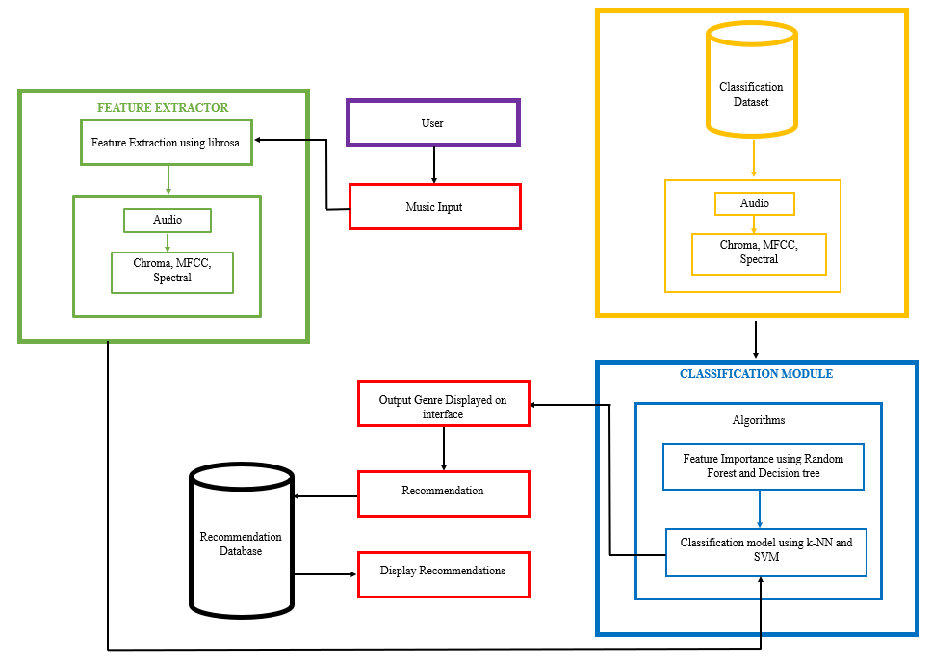
Legend:
Feature Extractor
Classification Dataset
Classification Module
Website Interface
Recommendation Database
User
System Architecture

Slide 23
DATA FLOW DIAGRAM

Slide 24
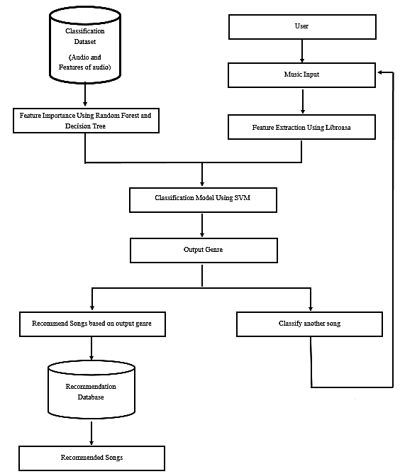

Slide 25
EXPLANATION OF PROJECT MODULES IDENTIFIED

Slide 26
PROJECT MODULES
1. Feature Extraction: It serves as the initial stage in the data processing pipeline, where raw audio input from the user is analyzed and transformed into a set of representative features.
2. Classification Module: It leverages various machine learning algorithms to analyze the extracted features and classify the music into predefined genres.
3. Recommendation Module: The Recommendation Module's primary purpose is to generate a list of music recommendations for the user based on the genre classified by the Classification Module.
4. User Interface: The User Interface (UI) of a music genre classification and recommendation system plays a crucial role in providing users with a seamless and intuitive experience.

Slide 27
UML DIAGRAMS

Slide 28
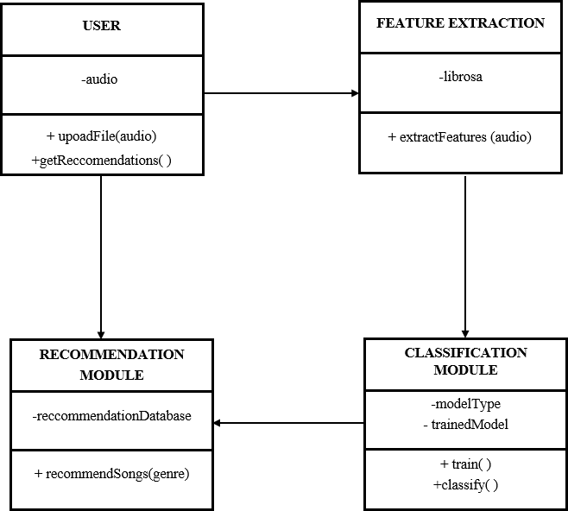
UML CLASS DIAGRAM
UML Class Diagram represents the the flow and interaction between various components in a music recommendation system. Basically, flow starts with user and followed by other modules such as:
Feature Extraction
Classification Module
Recommendation Module

Slide 29
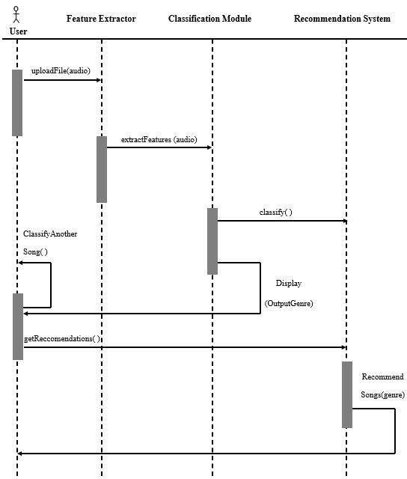
UML SEQUENCE DIAGRAM
The sequence diagram illustrates the interaction between the user and the system components: Feature Extractor, Classification Module, and Recommendation System.
The process begins with the user uploading an audio file through the uploadFile(audio) method, which is sent to the Feature Extractor.
The Feature Extractor then processes the audio to extract relevant features using the extractFeatures(audio) method.
These extracted features are passed to the Classification Module, which determines the genre of the music by invoking the classify() method.

Slide 30
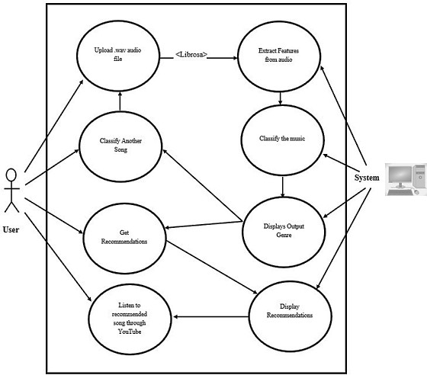
UML USECASE DIAGRAM
The diagram represents a system designed to classify music and provide recommendations based on the user's uploaded audio files.
The process begins with the user uploading a .wav audio file, from which the system extracts features using the librosa library, a popular Python package for music and audio analysis.
These features are crucial for analyzing the content and characteristics of the music. Once the features are extracted, the system classifies the music into a specific genre, which is then displayed to the user.

Slide 31
PROJECT IMPLEMENTATION SECTION

Slide 32
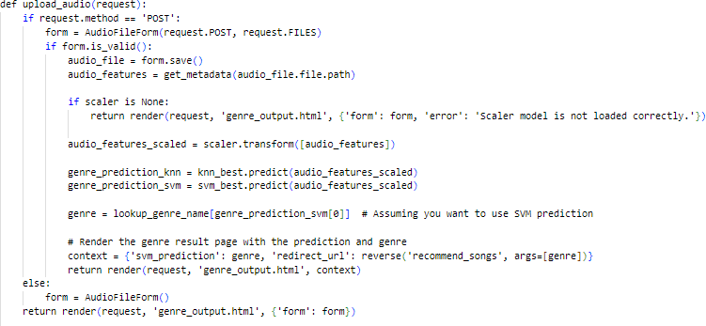
CODE SNIPPETS
This function handles the uploading of an audio file, processes it to predict its genre using machine learning models, and then renders a template to display the result along with a recommendation link.

Slide 33
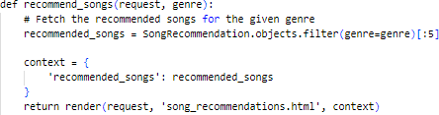
CODE SNIPPETS
This function is designed to show a list of recommended songs based on the genre provided. It queries the database for song recommendations, limits the results to the top 5, and then renders them in a template for display.

Slide 34
PROJECT DEMONSTRATION SECTION

Slide 35
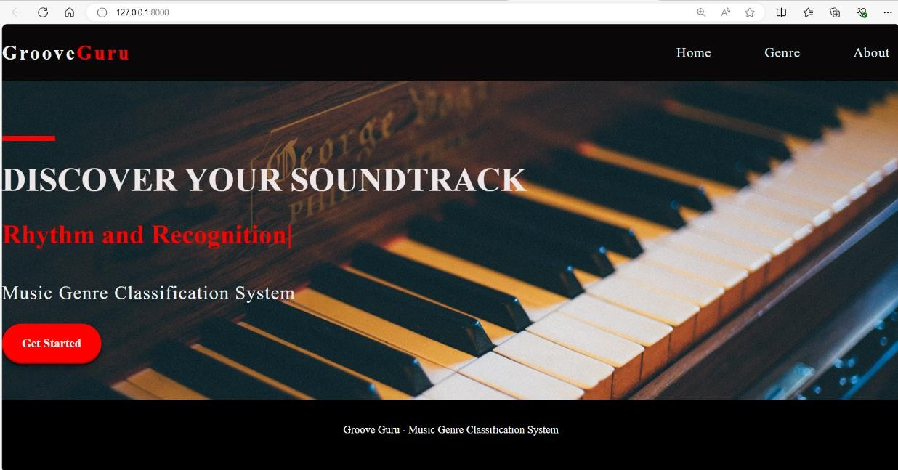
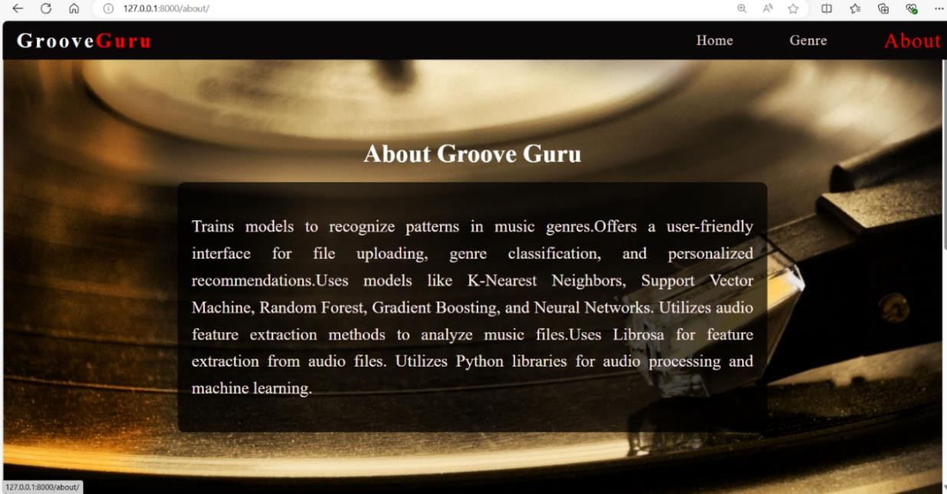
DETAILS OF PROJECT DEMONSTRATION

Slide 36

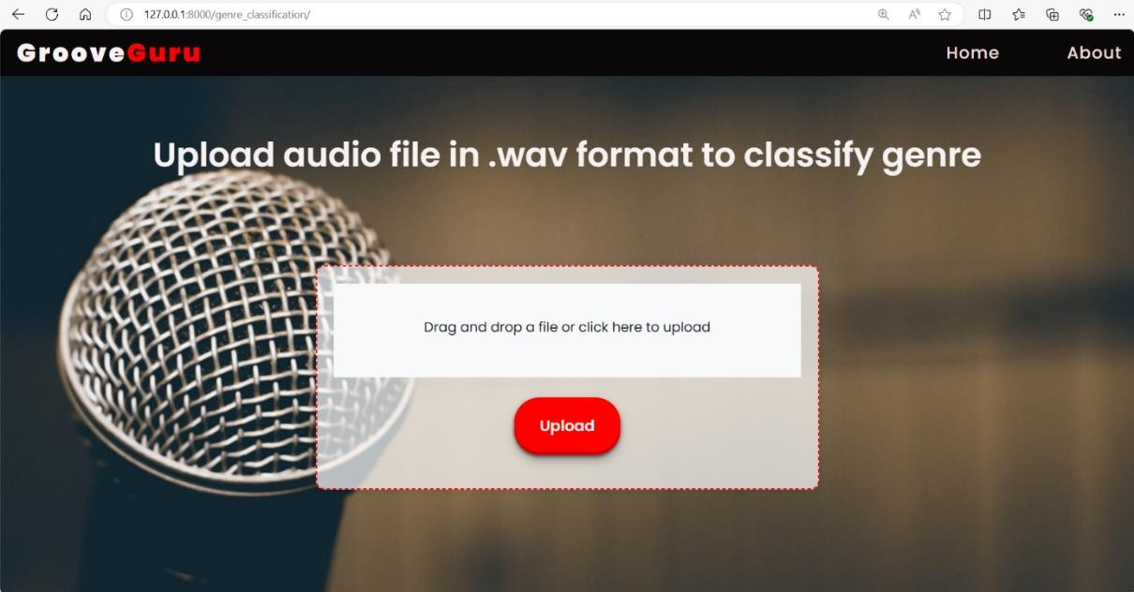
DETAILS OF PROJECT DEMONSTRATION

Slide 37
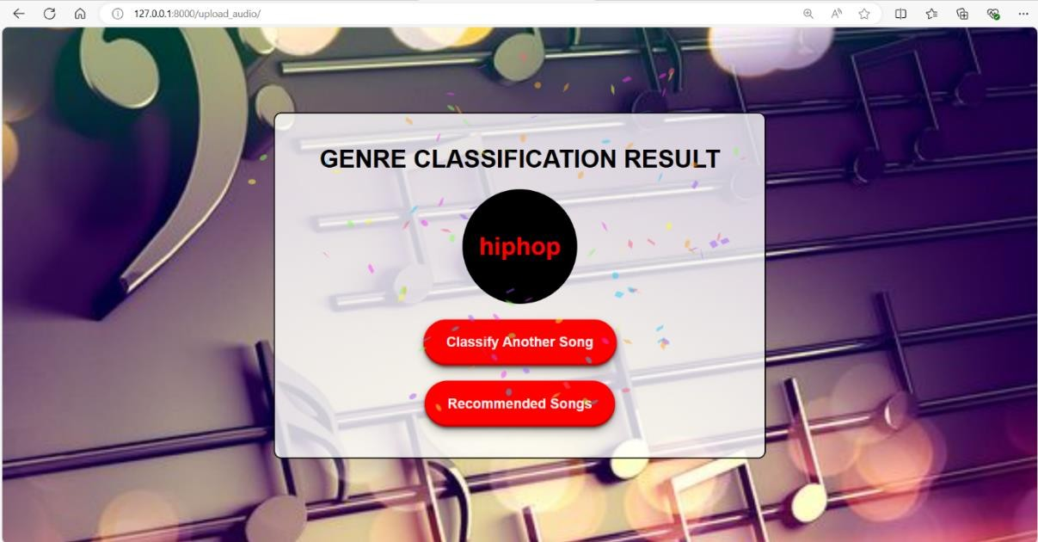
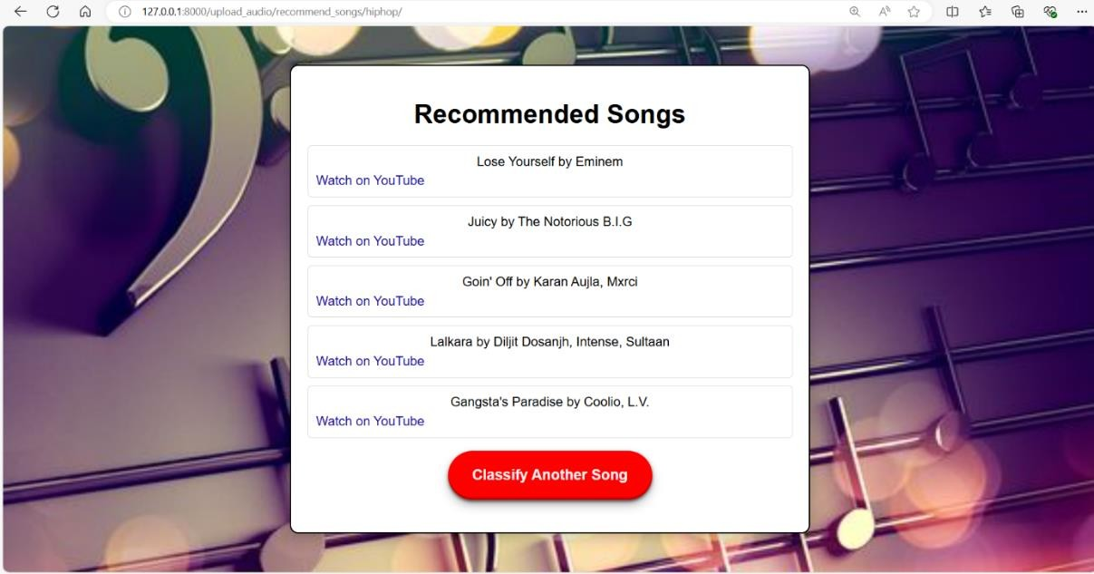
DETAILS OF PROJECT DEMONSTRATION

Slide 38
DETAILS OF TESTING & TESTING RESULTS

Slide 39
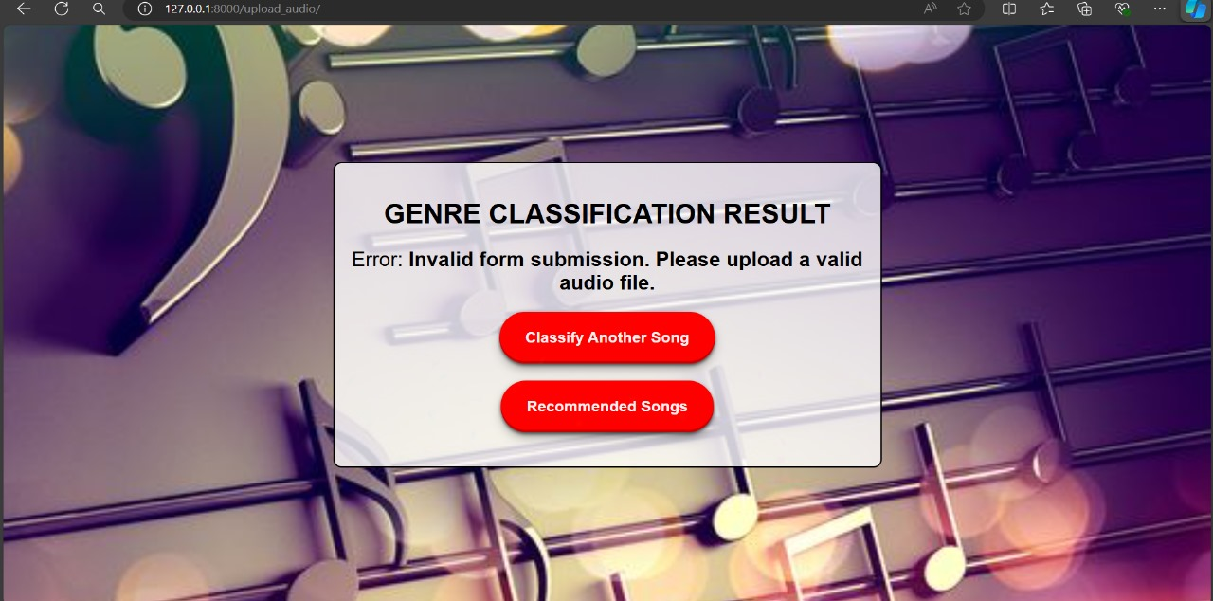
DETAILS OF TESTING & TESTING RESULTS
5.1. UNIT TESTING
To ensure that the genre classification and recommendation system is functioning correctly and efficiently, providing accurate results based on the implemented machine learning models.
Uploading .wav audio file
Uploading invalid audio file format

Slide 40
DETAILS OF TESTING & TESTING RESULTS
5.2. ACCEPTANCE TESTING
To verify that the genre classification and recommendation system meets all specified requirements and performs accurately and efficiently in a real-world scenario.
Genre classified
Recommending songs based on classified genre

Slide 41
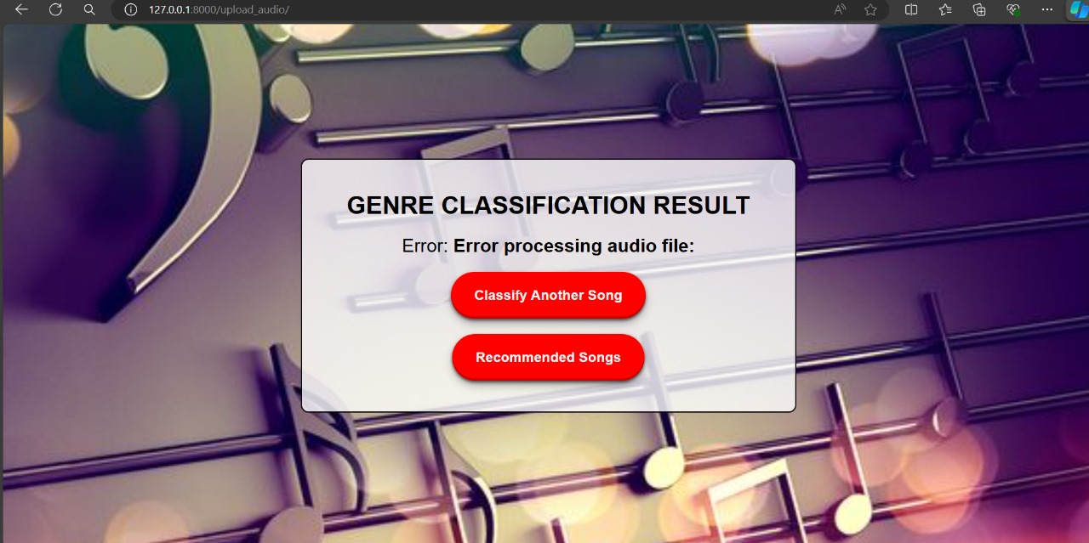
DETAILS OF TESTING & TESTING RESULTS
5.3.INTEGRATION TESTING
To verify that the integrated components of the genre classification and recommendation system interact correctly and provide accurate and efficient results.
Uploading .wav audio file
Uploading invalid audio file format which cannot extract features

Slide 42
DETAILS OF TESTING & TESTING RESULTS
5.4. SYSTEM TESTING
To validate that the system meets its functional requirements.
To ensure the system's performance, security, and usability.
To verify that the system works as expected in a real-world environment.
To identify and resolve any defects before the system is deployed to production.

Slide 43
CONCLUSION & FUTURE SCOPE

Slide 44
CONCLUSION
GrooveGuru significantly improves music discovery and organization through accurate genre classification and intelligent recommendations, enriching users' musical experiences.
By utilizing advanced audio feature extraction techniques and robust machine learning models, GrooveGuru offers a sophisticated solution tailored to modern music enthusiasts.
GrooveGuru is committed to continually advancing its capabilities, including the integration of deep learning models such as convolutional and recurrent neural networks for enhanced accuracy.
Planned enhancements include real-time audio processing, allowing for instantaneous genre classification and recommendations during music playback.
GrooveGuru aims to redefine music discovery and user interaction, ensuring an enriched and personalized musical experience through continuous innovation and technological advancements.

Slide 45
FUTURE ENHANCEMENT
Cross-Platform Support: GrooveGuru will support multiple platforms, ensuring a seamless experience across different devices and operating systems.
GrooveGuru will integrate enhanced metadata to provide more detailed and useful information about music tracks, enriching the user experience.
The platform will feature intuitive user interfaces, making it easy for users to navigate and interact with the system.
GrooveGuru will support multiple platforms, ensuring a seamless experience across different devices and operating systems.
The inclusion of social features and personalized playlists will foster community engagement and provide tailored music experiences.

Slide 46
REFERENCES
[1] N. Kamuni and D. Panwar, “Enhancing Music Genre Classification through Multi-Algorithm Analysis and User-Friendly Visualization”, Apr. 2024, doi: 10.52783/jes.3178.
[2]A. S. Lampropoulos, P. S. Lampropoulouand G. A. Tsihrintzis, “A Cascade-Hybrid Music Recommender System for mobile services based on musical genre classification and personality diagnosis”, vol. 59, no. 1, Jul. 2012, doi: 10.1007/S11042-011-0742-0.
[3]A. Rosner and B. Kostek, “Automatic music genre classification based on musical instrument track separation”, vol. 50, no. 2, Apr. 2018, doi: 10.1007/S10844-017-0464-5.
[4]Y. Li, Z. Zhang, H. Dingand L. Chang, “Music genre classification based on fusing audio and lyric information”, vol. 82, no. 13, Dec. 2022, doi: 10.1007/s11042-022-14252-6.
[5]Y. Song, S. Dixonand M. Pearce, “A Survey of Music Recommendation Systems and Future Perspectives”, Jun. 2012.
[6]“librosa-librosa 0.10.2 documentation”, Jul. 10,2024. http://librosa.org/doc/latest/index.html (accessed Jul. 25, 2024).
[7] “Documentation scikit-learn: machine learning in Python – scikit-learn 0.21.3 documentation”. http://scikit-learn.org/0.21/documenation.html (accessed Jul. 25,2024)

Slide 47
THANK YOU

